Slide 1

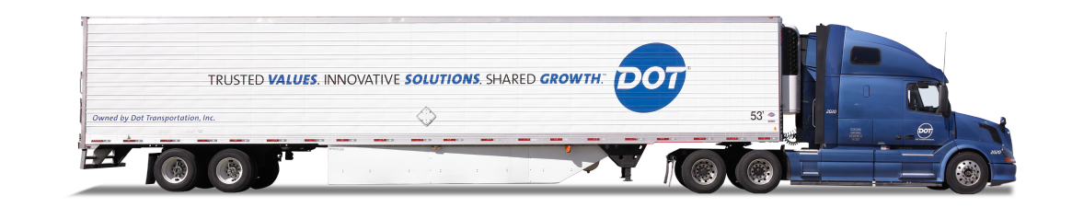
DOT FOODS
Project Proposal

Slide 2

AGENDA
01
INTRODUCTION
02
DASHBOARD DESIGNS
03
DATA INSIGHTS
04
FEEDBACK

Slide 3
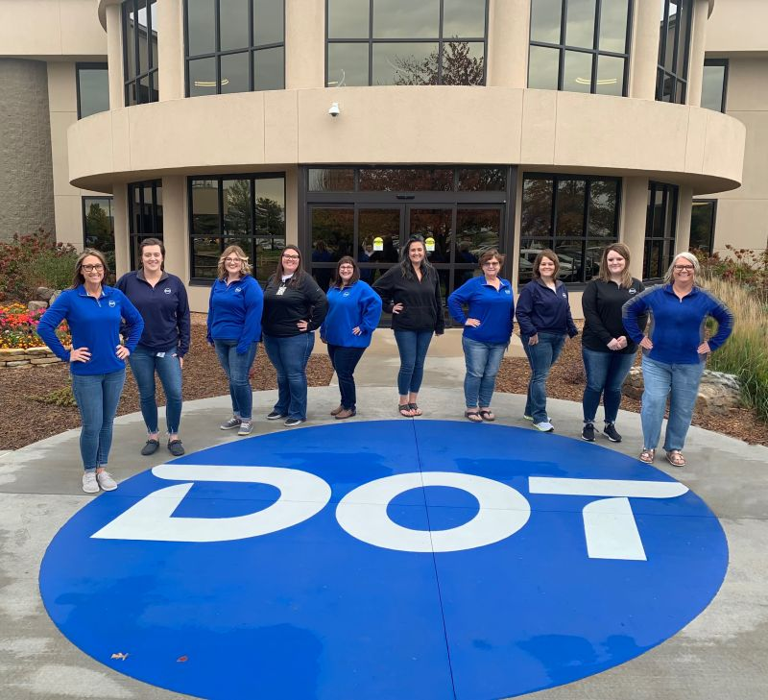
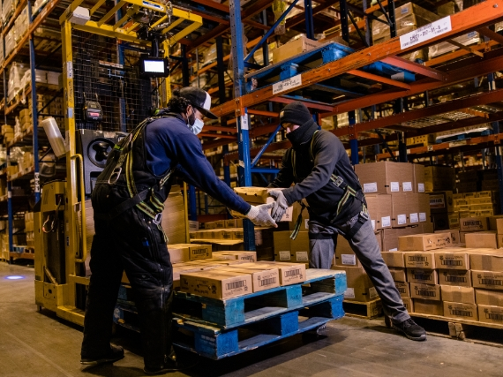
INTRODUCTION
Dot Foods aims to enhance its sales strategy by leveraging data-driven insights.
Sales reps need a 360° customer view for effective engagement.
Current challenges include manual data lookups, inconsistent customer segmentation, and lack of predictive insights.

Slide 4
DASHBOARD PLAN
Specific Company
Tier
Order Frequency Per Company

Slide 5

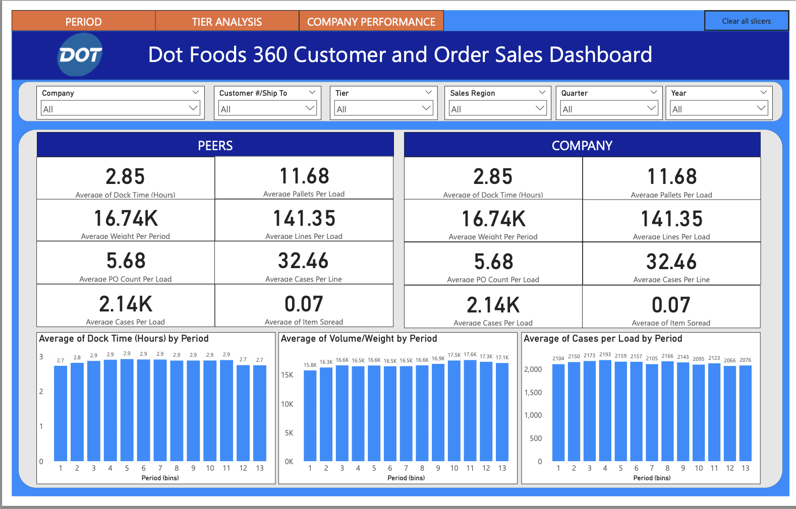

DASHBOARD
The dashboard tracks Dock Time, Cases per Load, and Volume/Weight over defined time periods (binned into 13 intervals)
These metrics help understand logistical performance trends, peak operational loads, and consistency in handling efficiency over time
The use of period-based bins supports temporal analysis and comparisons across different phases of shipment activity

Slide 6
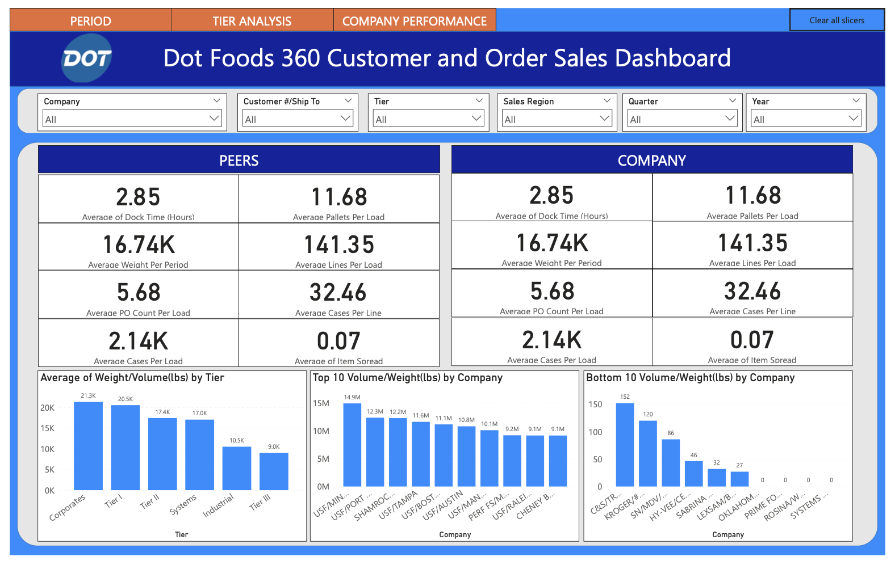
DASHBOARD
Tier segmentation (e.g., Tier I, II, III, Corporate, etc.) allows for performance benchmarking across customer types based on Weight/Volume.
Separate visuals highlight the Top and Bottom companies by shipment volume—this aids in identifying key partners and low-volume outliers.
Useful for strategic account management, resource allocation, and prioritizing high-impact clients.
f

Slide 7
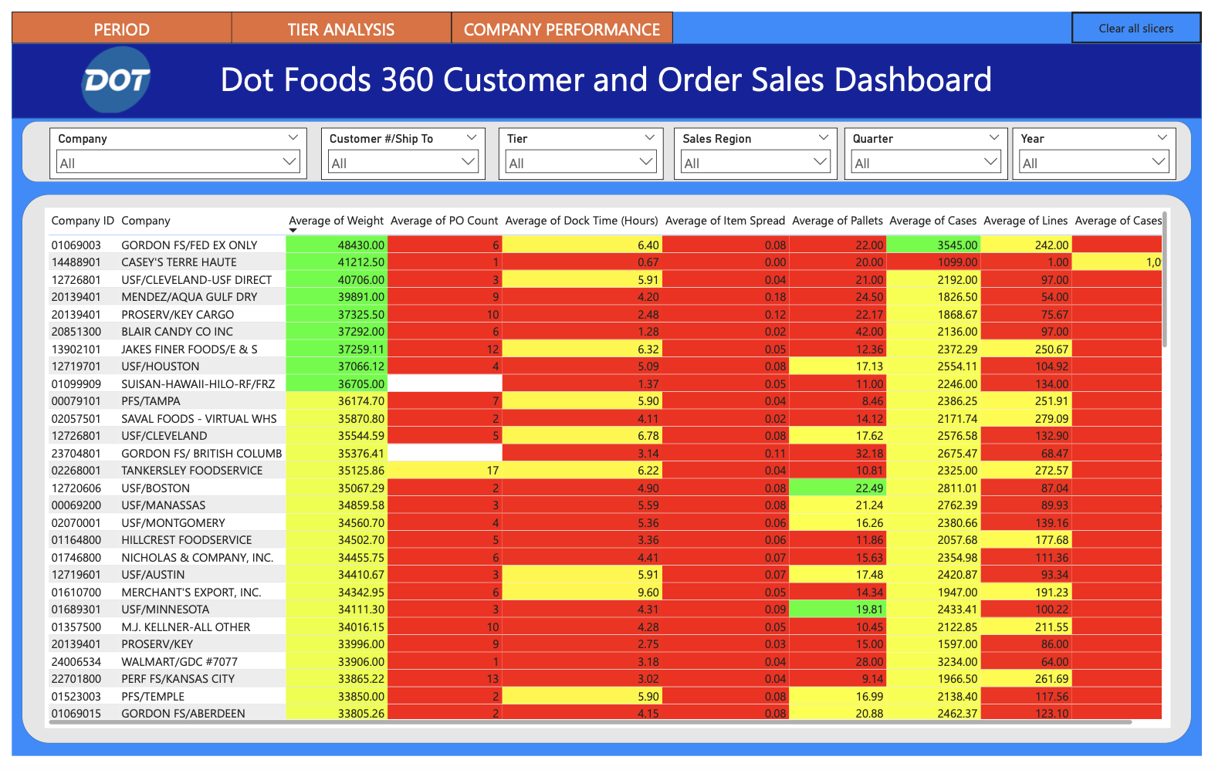
DASHBOARD
Variables like PO Count, Dock Time, Item Spread, Pallet Count, Case Count, and Line Items are tracked for each customer.
This enables multi-dimensional performance assessment per customer—across efficiency, load density, and SKU diversity.
Helps uncover operational bottlenecks, optimize loading strategies, and improve partner-specific logistics.

Slide 8


DOT FOODS
FEEDBACK

Slide 9



THANK YOU!
DOT FOODS

